Slide 1
Own It! Workshop
Dr. Eisenberg
Eti Berland
Sarah Burnstein

Slide 2
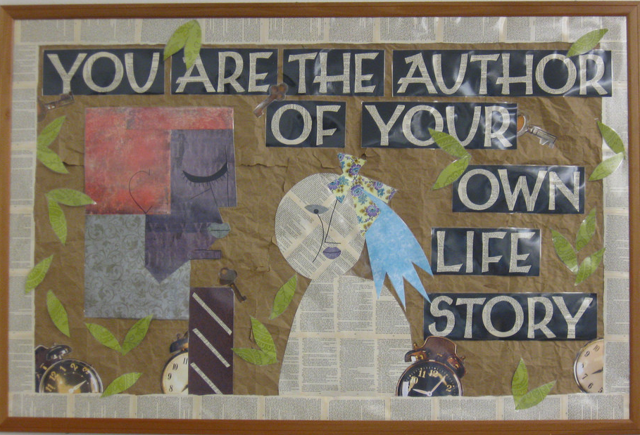
Responsibility
=
Response Ability

Slide 3
Communication

Slide 4
Communication

Slide 5
Communication

Slide 6
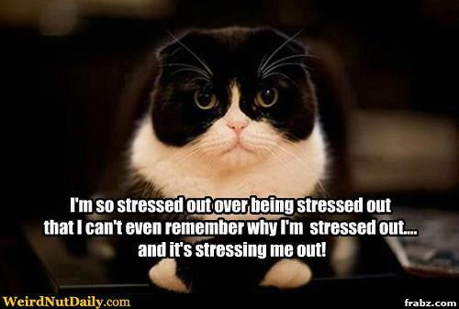
Stress Management

Slide 7
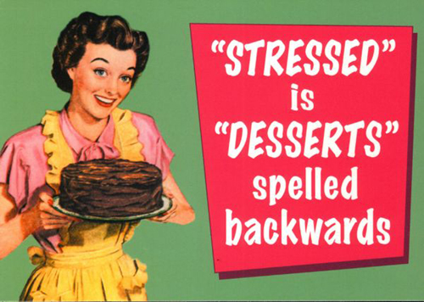
How do you
deal with stress?

Slide 8
Stress Management

Slide 9
Goal Setting

Slide 10
Goal Setting

Slide 11
Prioritizing

Slide 12
Prioritizing

Slide 13
Prioritizing

Slide 14
Prioritizing

Slide 15
Prioritizing

Slide 16
Prioritizing

Slide 17
Blaming

Slide 18
Scheduling

Slide 19
Own It Programs!
Interviewing
Creativity
Financial planning
Stress management
Digital footprint
Your ideas!

Slide 20
It’s Your Life. Own It!

