Slide 1
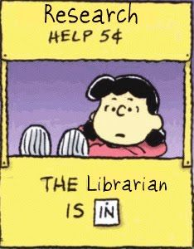
ENG 111: Composition:
Critical Analysis & Research
Research Guide

Slide 2
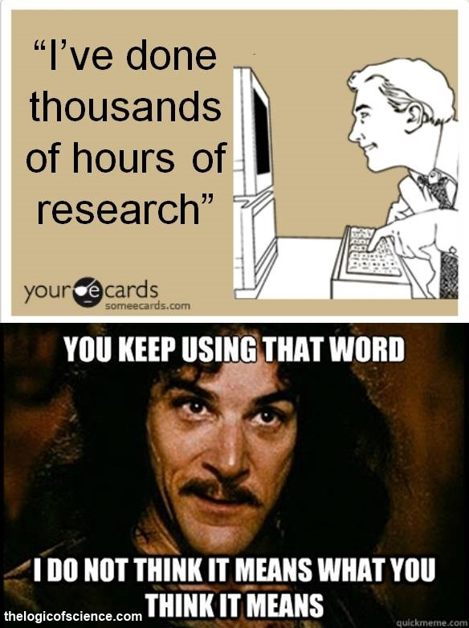
Source: https://thelogicofscience.files.wordpress.com/2015/11/research-you-keep-using-that-word.jpg

Slide 3
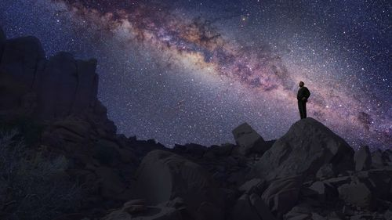
Literary Term Paper:
Themes

Slide 4
The Big6™ Skills
1. Task Definition
2. Info Seeking Strategies
3. Location & Access
4. Use of Information
5. Synthesis
6. Evaluation
Source: http://big6.com/pages/free-stuff.php

Slide 5
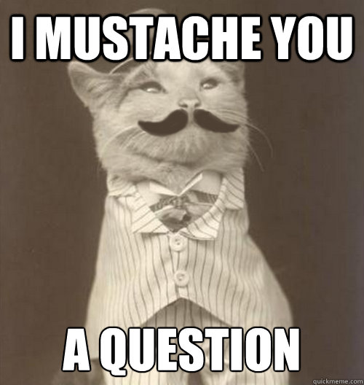
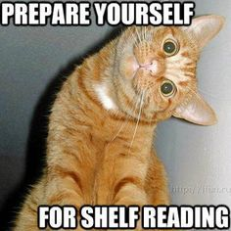
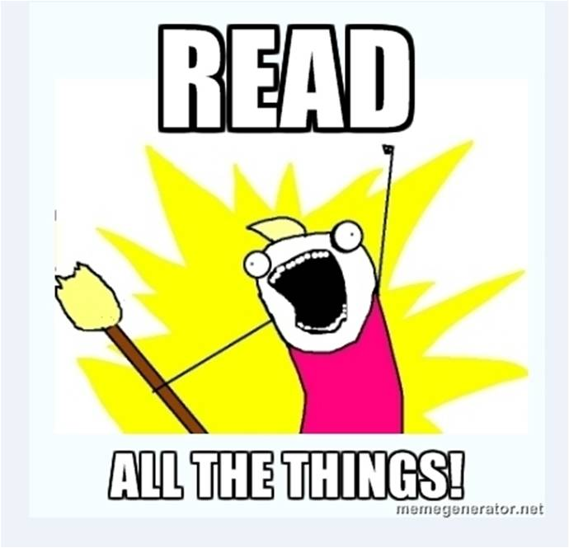
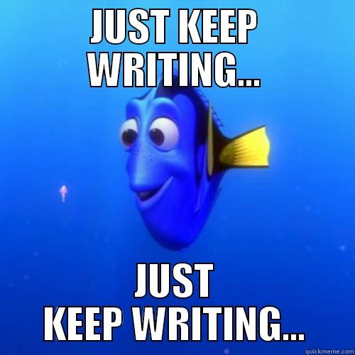
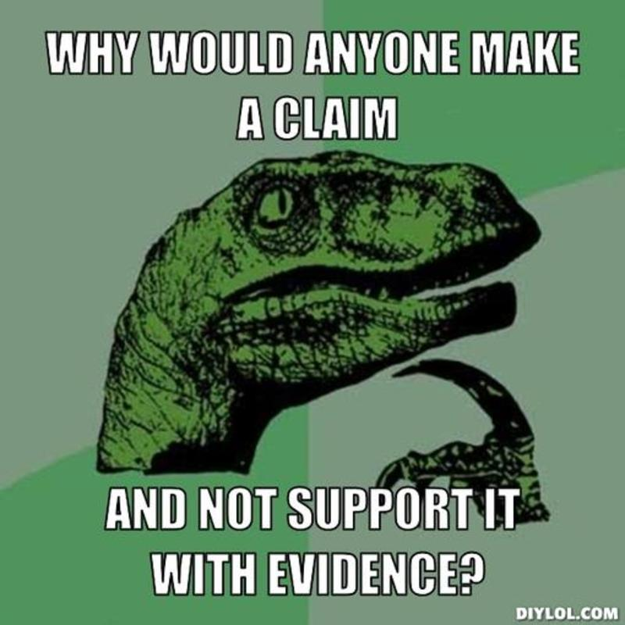
Task Definition: What is your question?
Information Seeking Strategies:
How & Where will you look for information?
Location & Access: Finding & Using information
Synthesis:
Constructing your
product
Use of Information:
Extracting what you need
Assessment: How will you judge your product?

Slide 6
The Big6: Not Linear
Source: http://big6.com/pages/free-stuff.php

Slide 7
Source: http://www.flickr.com/photos/will-lion/2595497078/

Slide 8
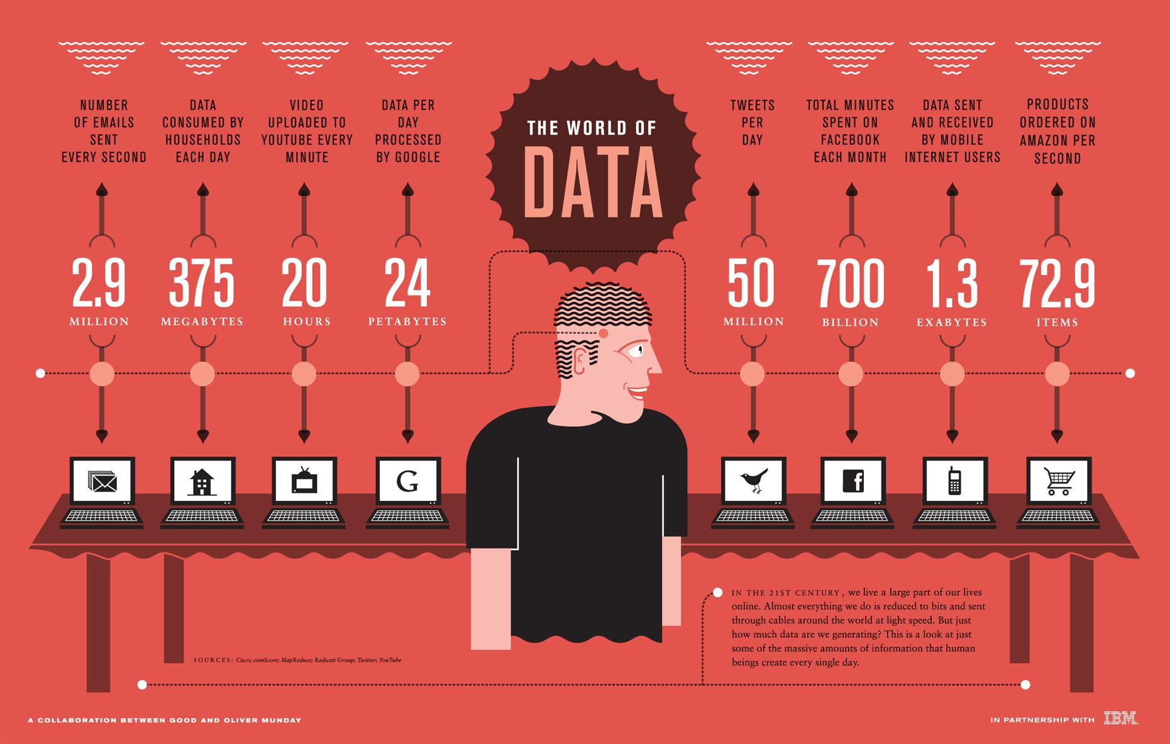
Source: https://gibsic.files.wordpress.com/2012/06/world-of-data.jpg

Slide 9
Resources for Research
Academic databases from Touro
http://htclibrary.weebly.com/research-databases.html
Google Scholar
Books
Journals, newspapers, magazines
TEDTalks
Documentaries
Podcasts
Interviews
Wikipedia
WorldCat or local Library catalog (HTC, Skokie, Chicago)

Slide 10
Advantages of Using Databases
Databases are collections of journal and magazine articles, reviews, reports, etc.
Peer-reviewed full-text articles
Information is organized
Easier to find results through subject headings

Slide 12
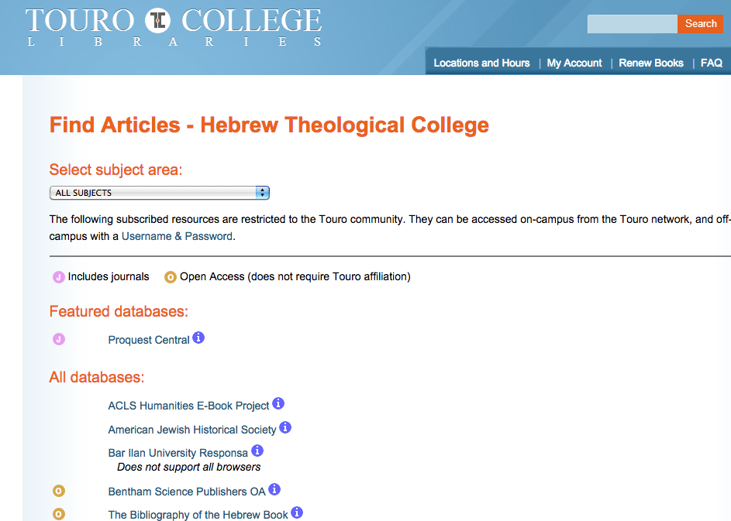

Slide 13
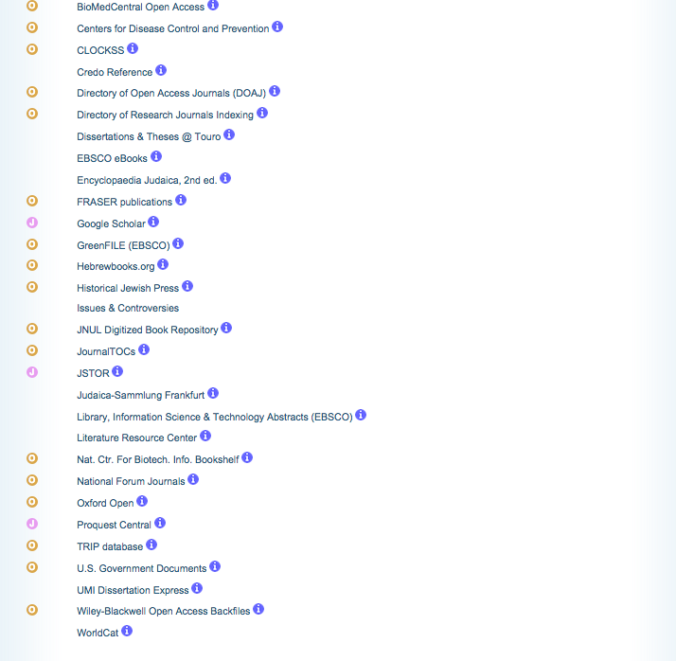

Slide 14
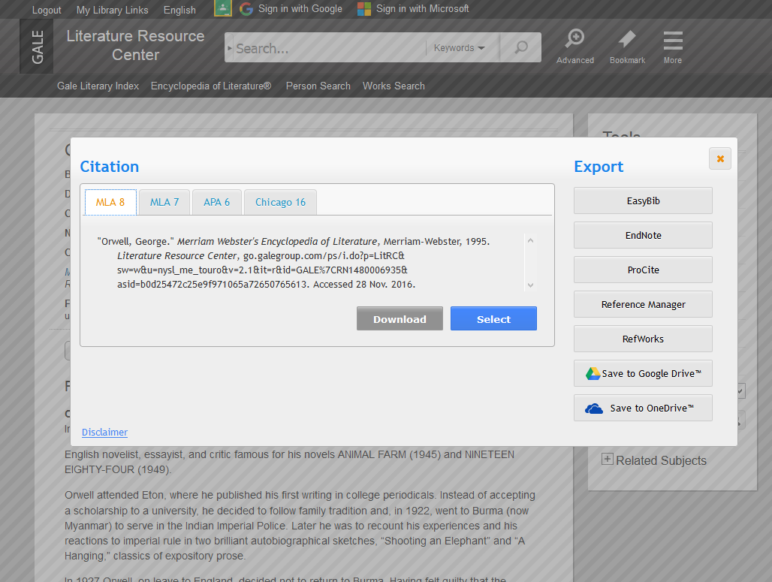
Get the citation!

Slide 15
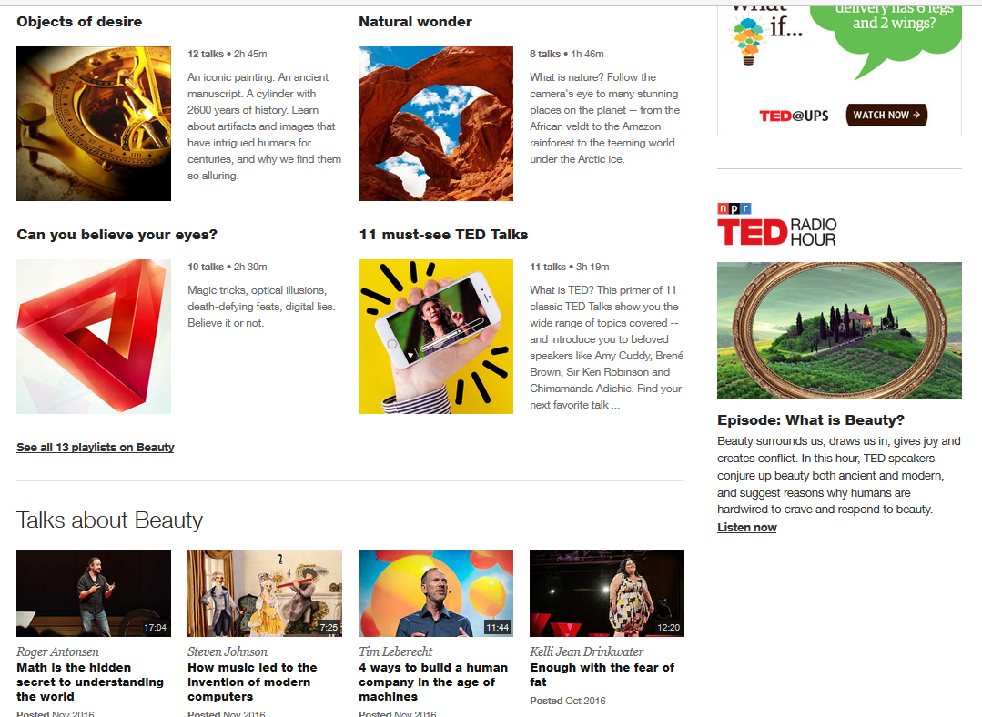

Slide 16
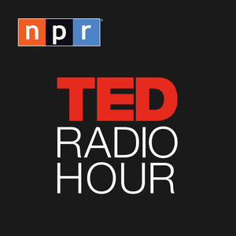
Podcasts
Source: http://www.slate.com/articles/podcasts/podcasts/2005/07/slates_podcasting_guide.html

Slide 17
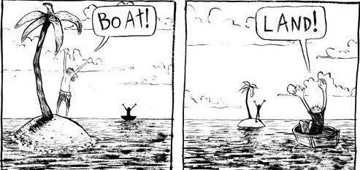
Evaluating Web Sites
Accuracy
Authority/Credibility
Domain and URL
Appearance
Sources
Objectivity/Bias
Currency/Relevance
Coverage

Slide 18
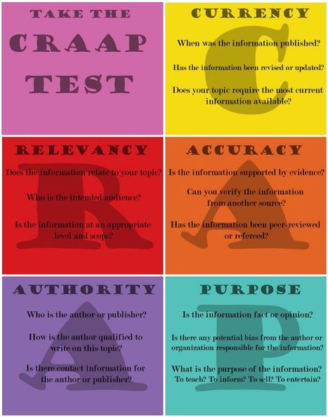
Source: https://img.scoop.it/AmsPHyt-Yz-r_OEZ0jem3Dl72eJkfbmt4t8yenImKBVvK0kTmF0xjctABnaLJIm9

Slide 19
Source: http://www.flickr.com/photos/info_grrl/5155808856/

Slide 20
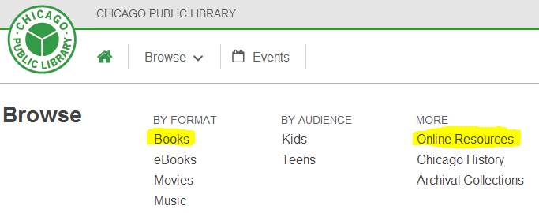
Don’t forget your Public Library!

Slide 21
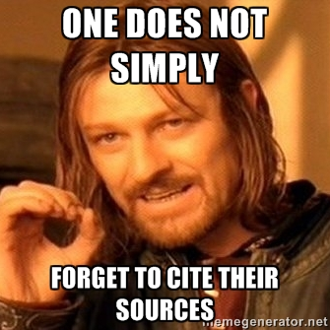
Citing Sources
Source: https://memegenerator.net/instance/65824925

Slide 22
Citation!
Most databases provide citations. Get them before you go!
WorldCat
Google Scholar
Citation Machine
Bib Me
Easy Bib
Purdue Online Writing Lab MLA Guide

Slide 24
Avoiding Plagiarism
What is Plagiarism?
Plagiarism is "the unauthorized use of the language and thoughts of another author and the representation of them as one's own” (New Webster's Encyclopedic Dictionary of the English Language 508).
Quoting, Summarizing, & Paraphrasing
Writing a paper is not a mimetic
Keeping track of sources
Academic Integrity Policy

Slide 25
Source: https://cdn.meme.am/instances/56377641.jpg

Slide 26
