Slide 1
What Can Our Library Do For You?
Saul Silber Memorial Library
Eti Berland, Head Librarian
Sarah Burnstein, Assistant Librarian

Slide 2
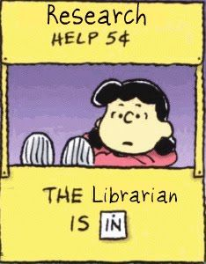
Source: https://www.lib.uwo.ca/blogs/education/Research%20Librarian%20is%20IN.jpg

Slide 3
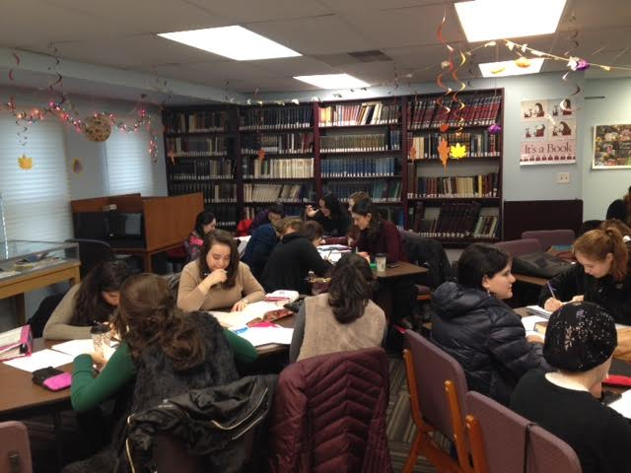
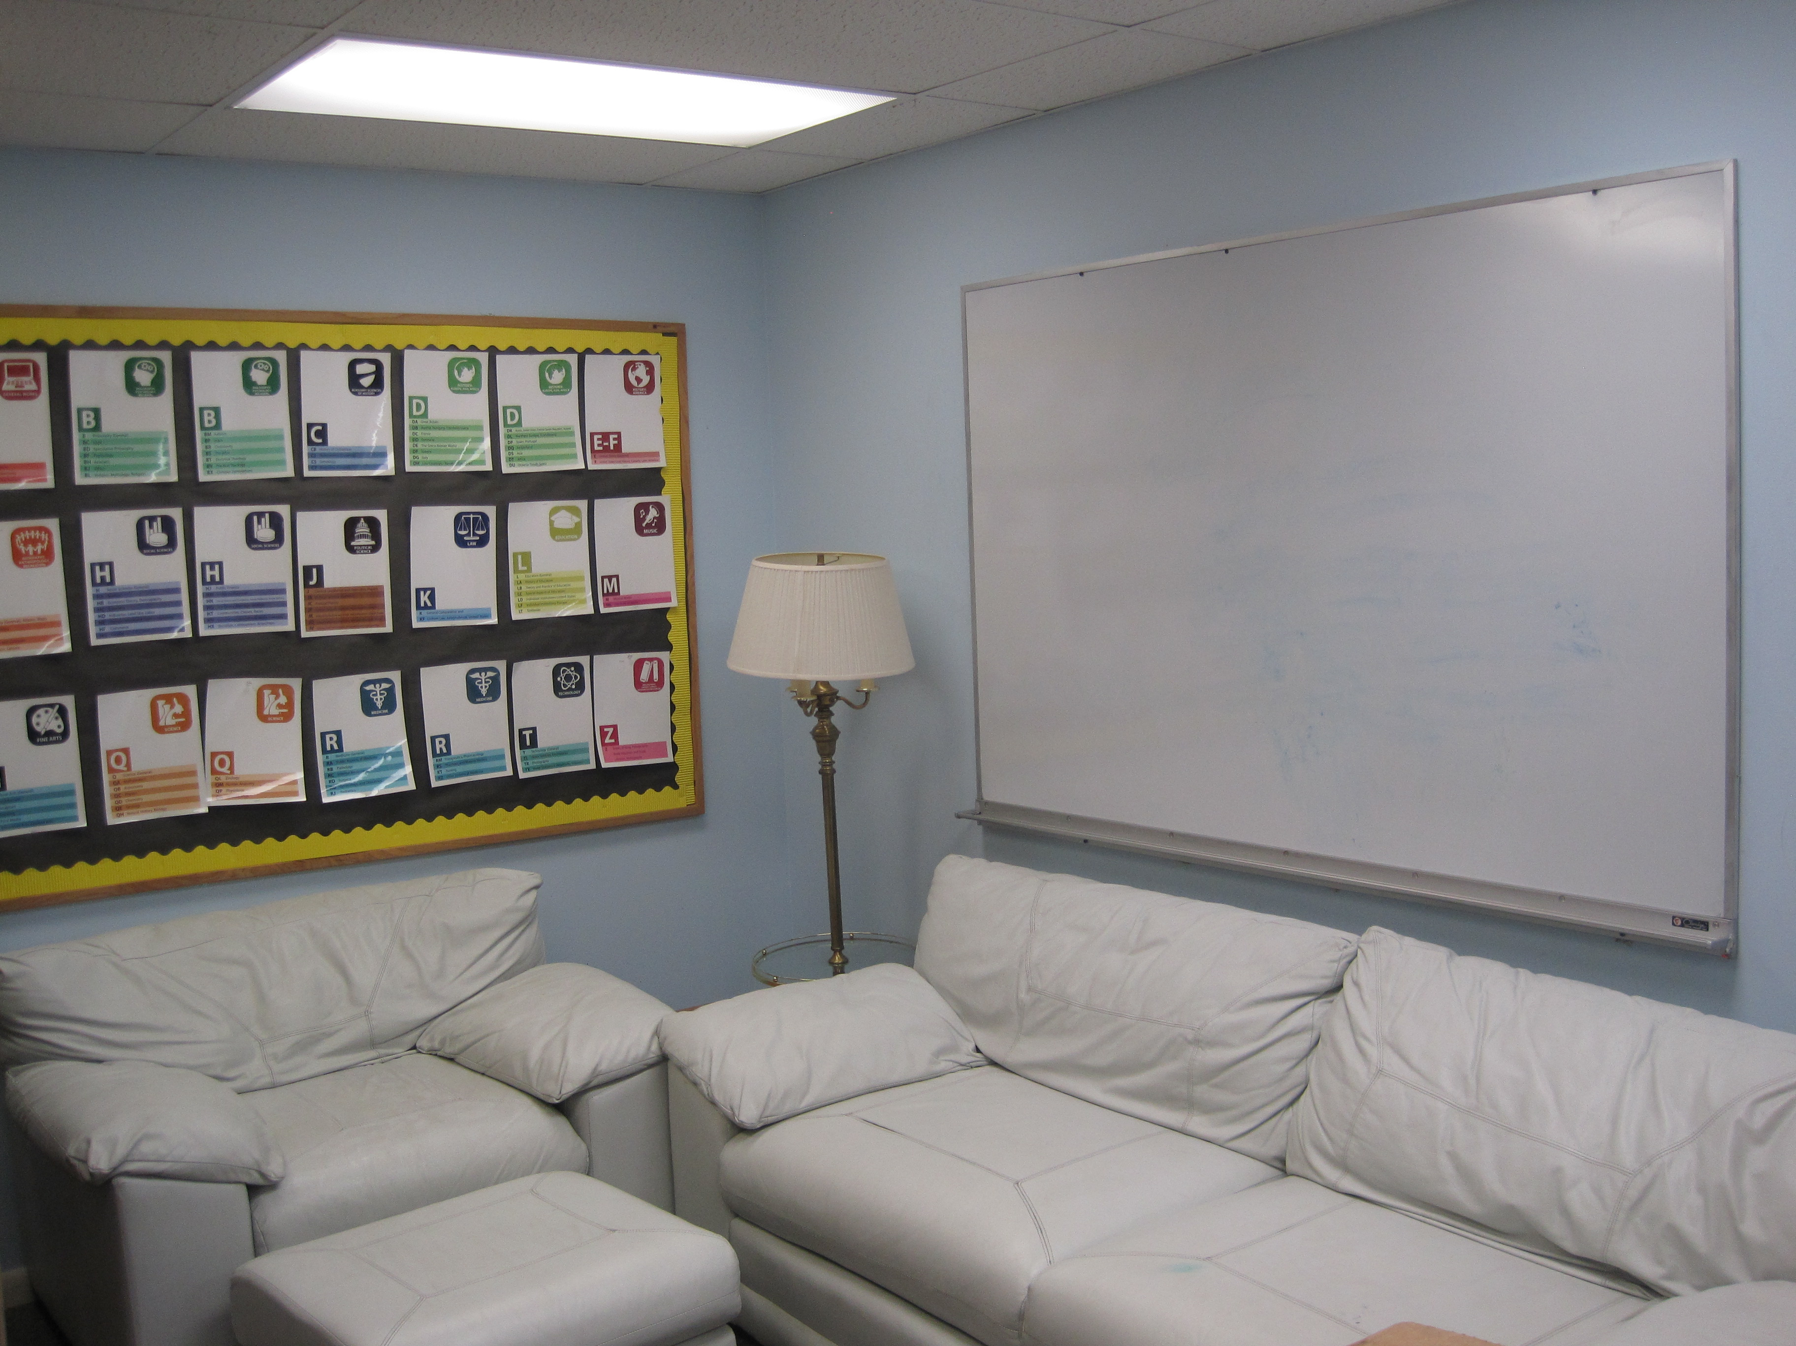
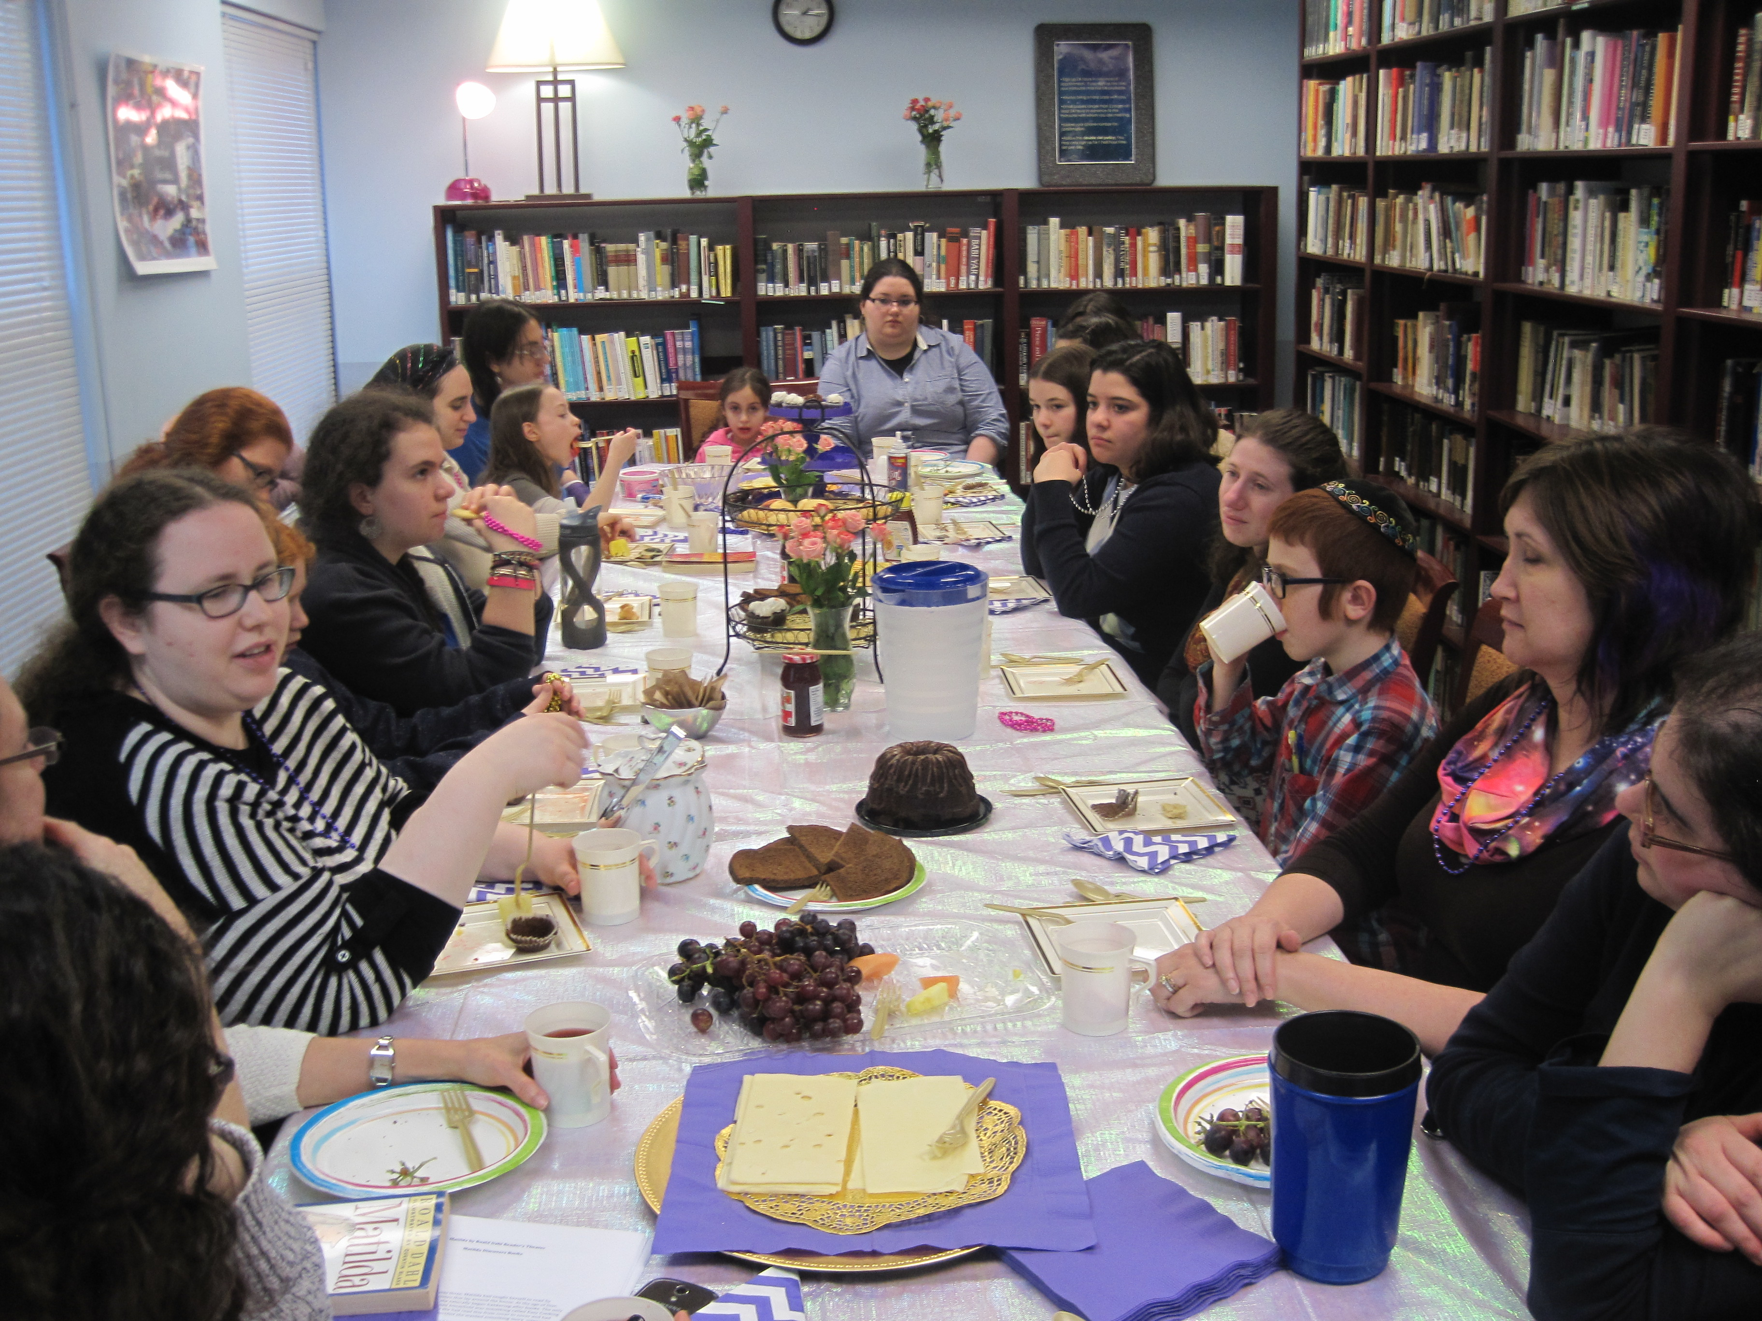
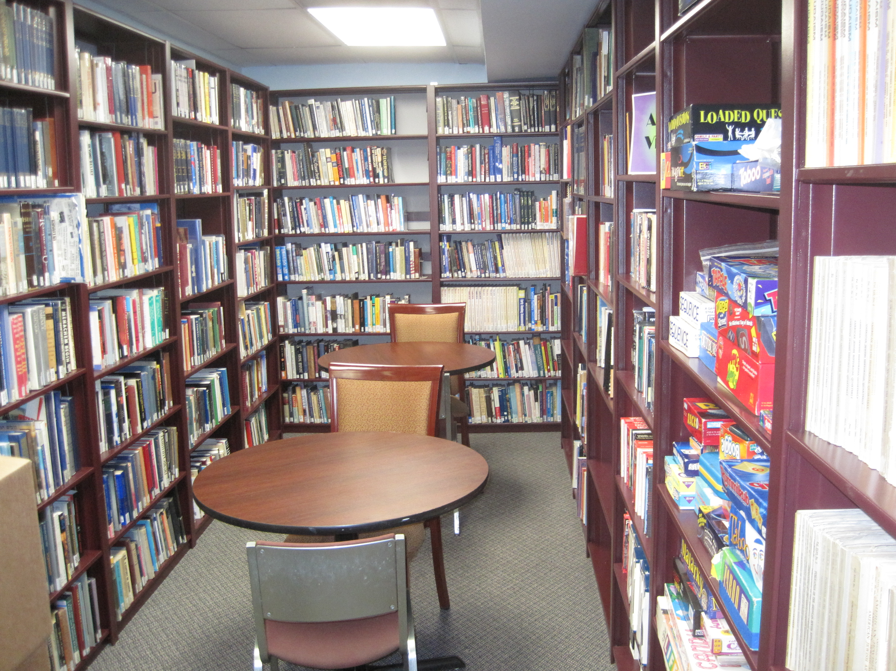
What is the library?
Main Room - Judaic Collection
Annex Room – General Studies Collection
Conference Room B – English/Lit Collection

Slide 4
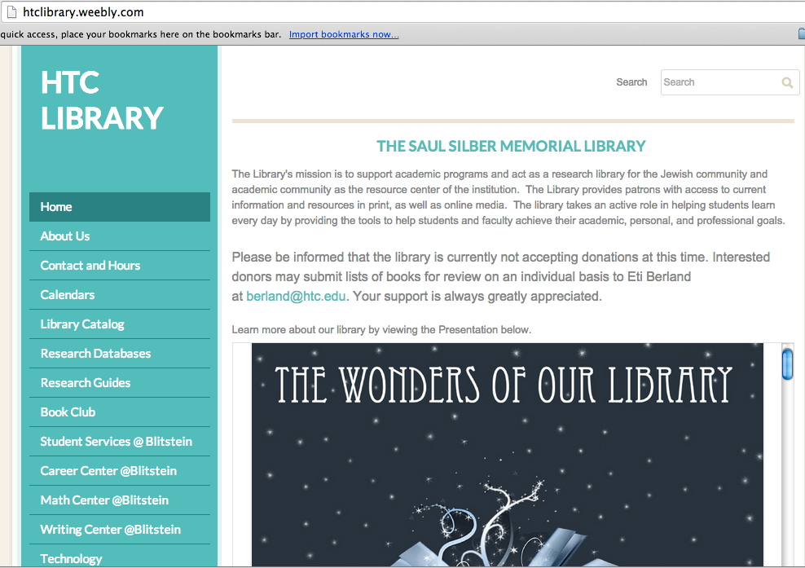
We also exist on the internet…

Slide 6
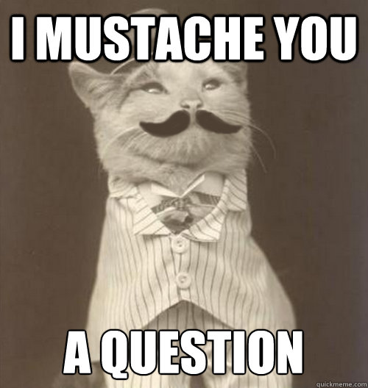
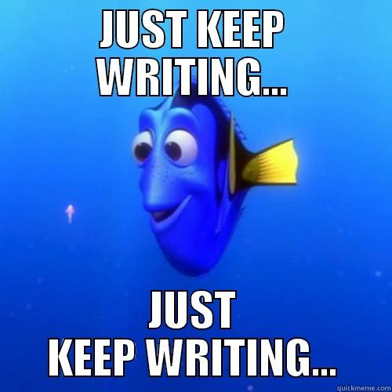
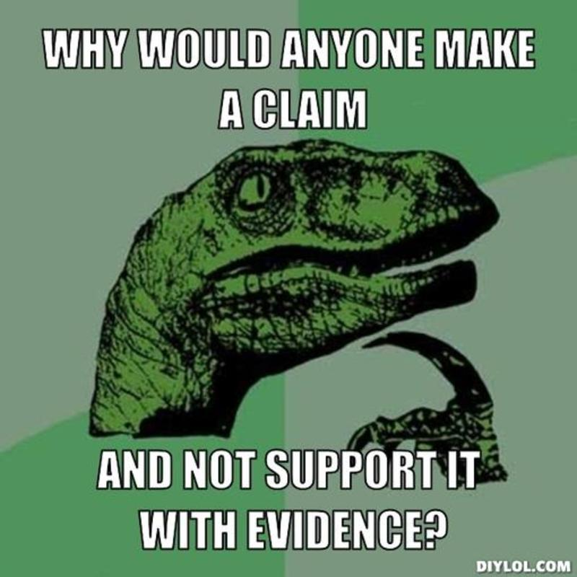
Task Definition: What is your question?
Information Seeking Strategies:
How & Where will you look for information?
Location & Access: Finding & Using information
Synthesis:
Constructing your
product
Use of Information:
Extracting what you need
Assessment: How will you judge your product?

Slide 7
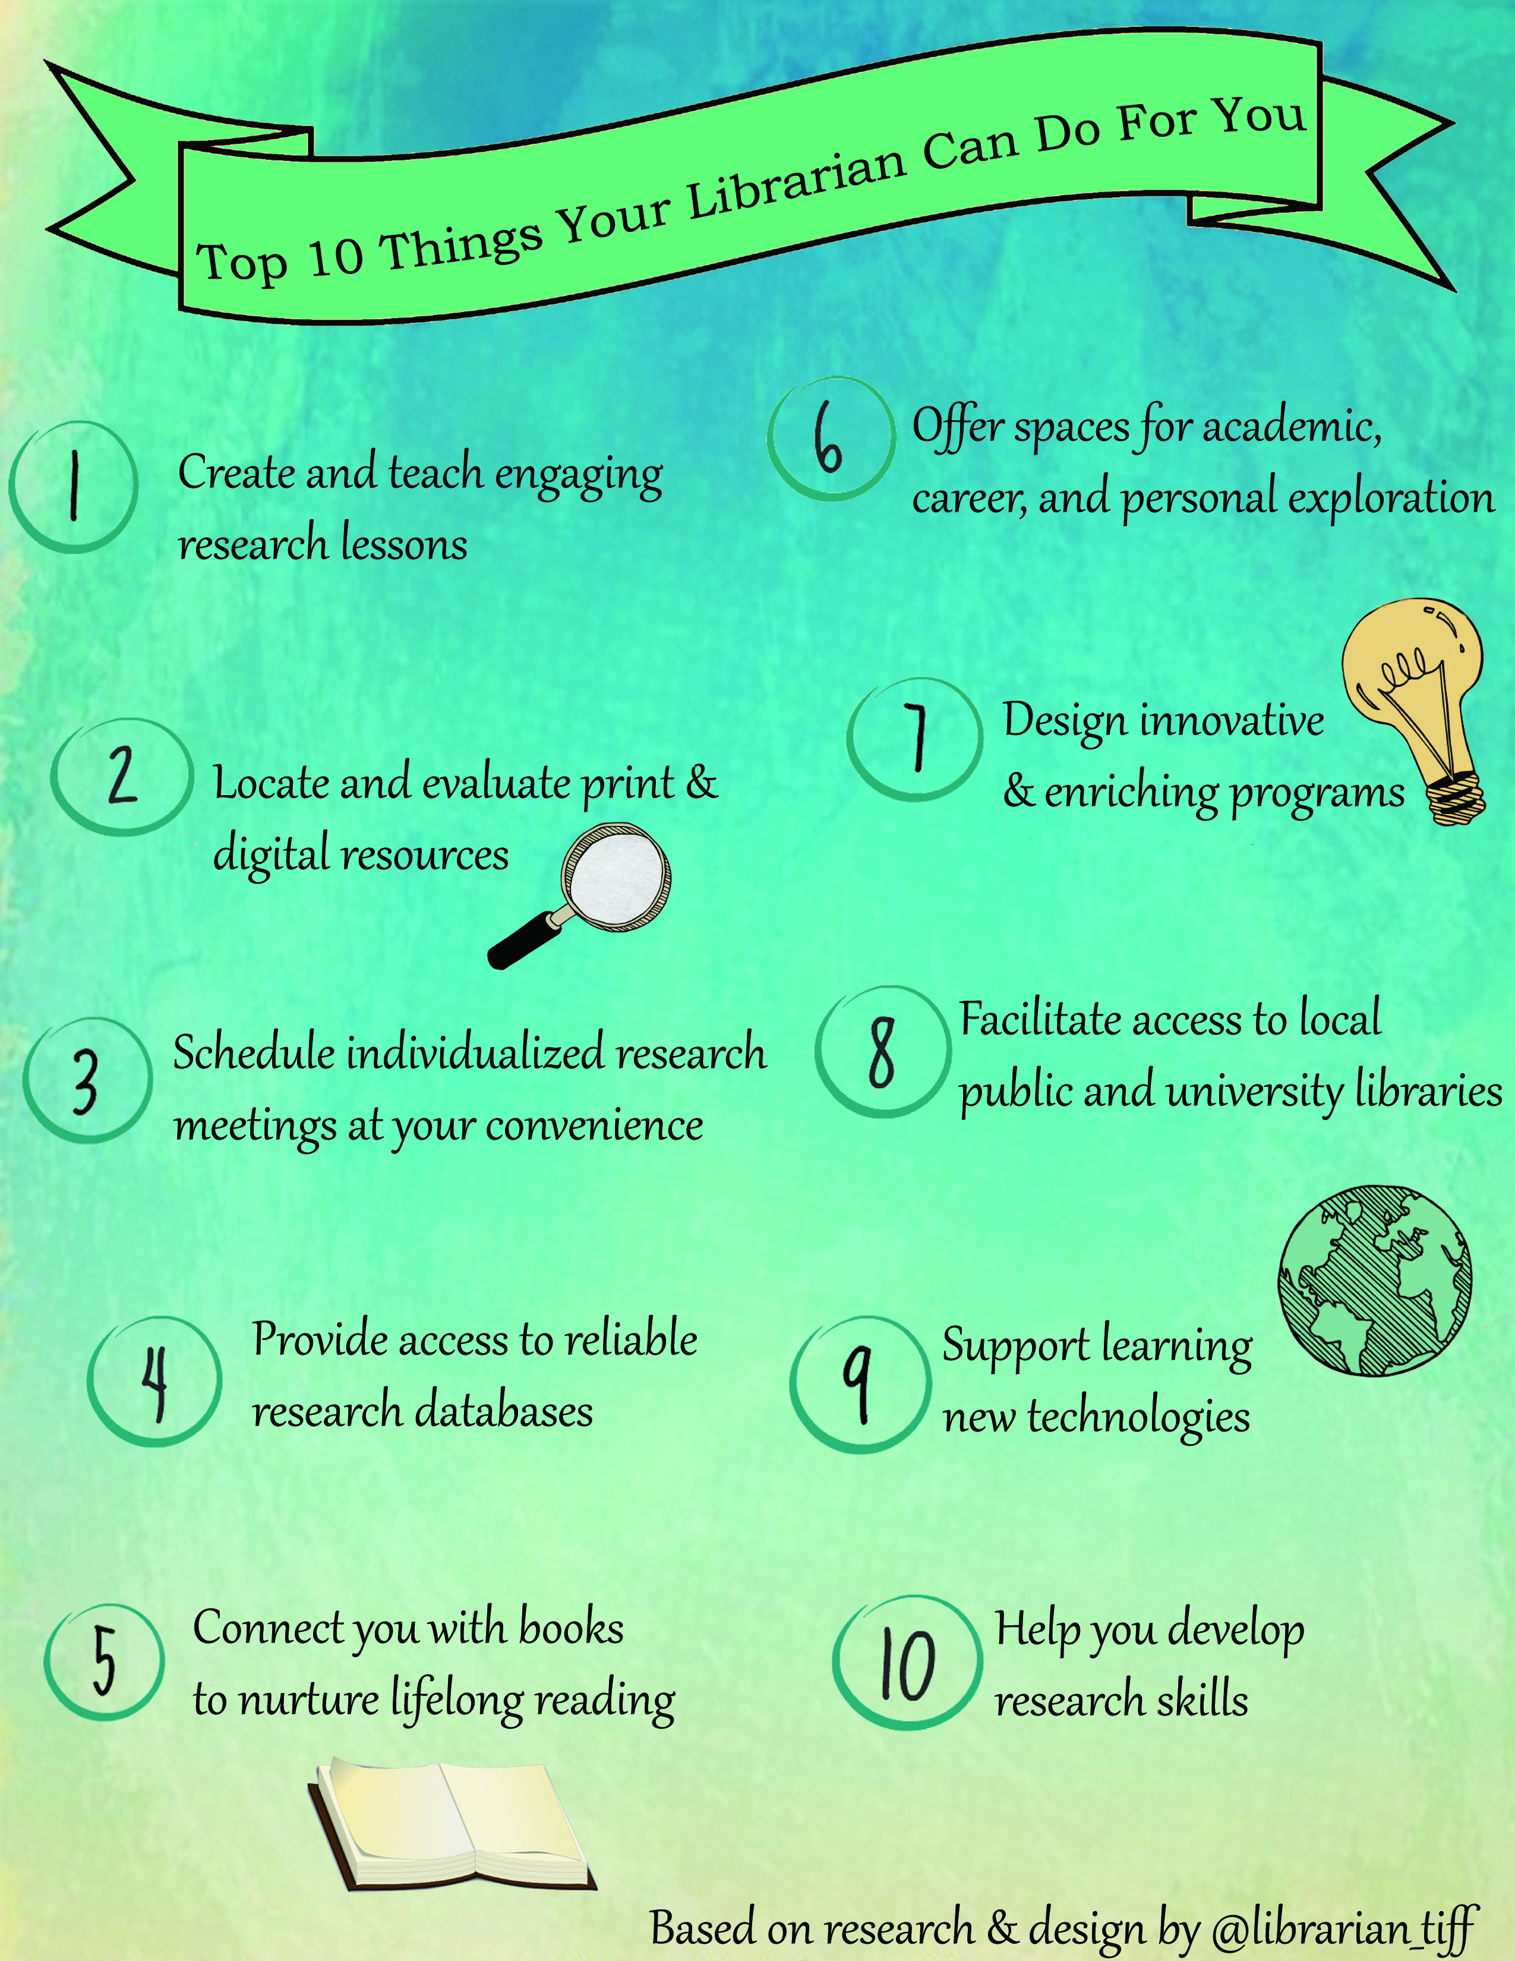

Slide 8
Technology
WIFI:
TI2008AB
Login:
First initial, last name
Password: 1234

Slide 9
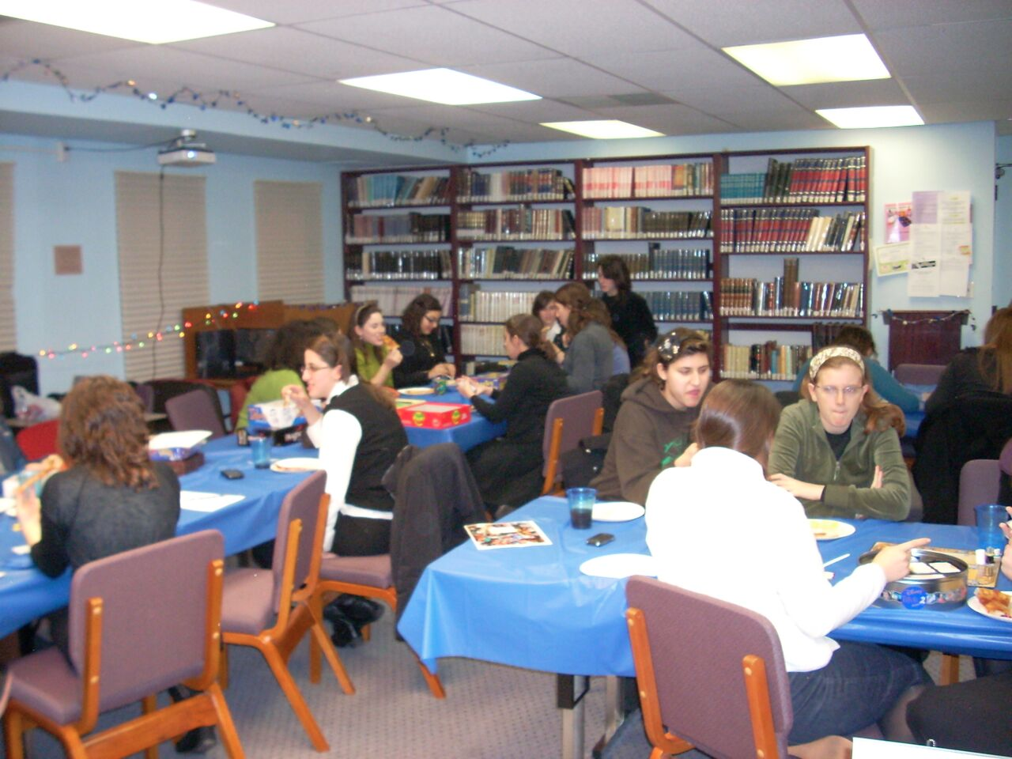
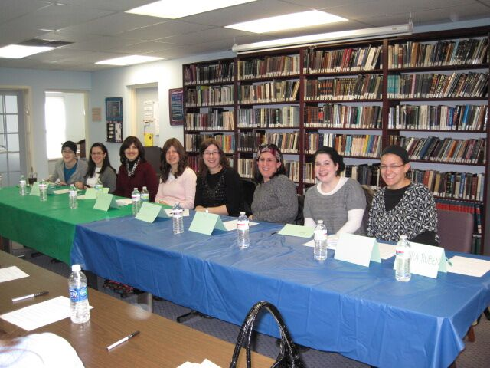
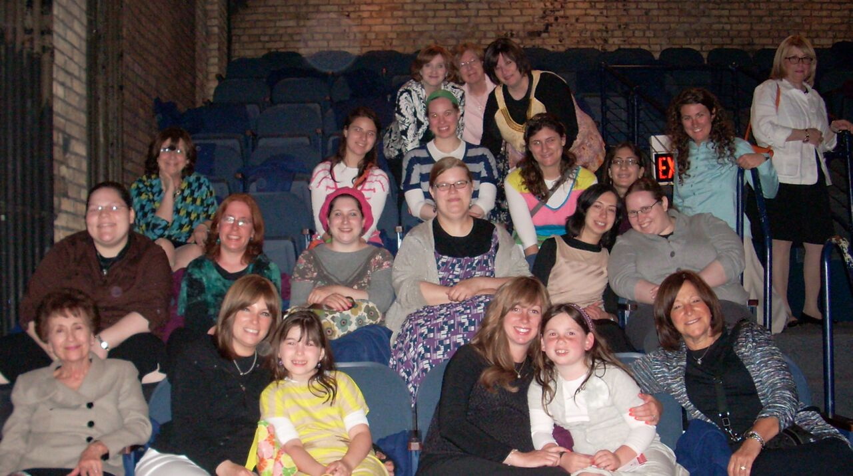
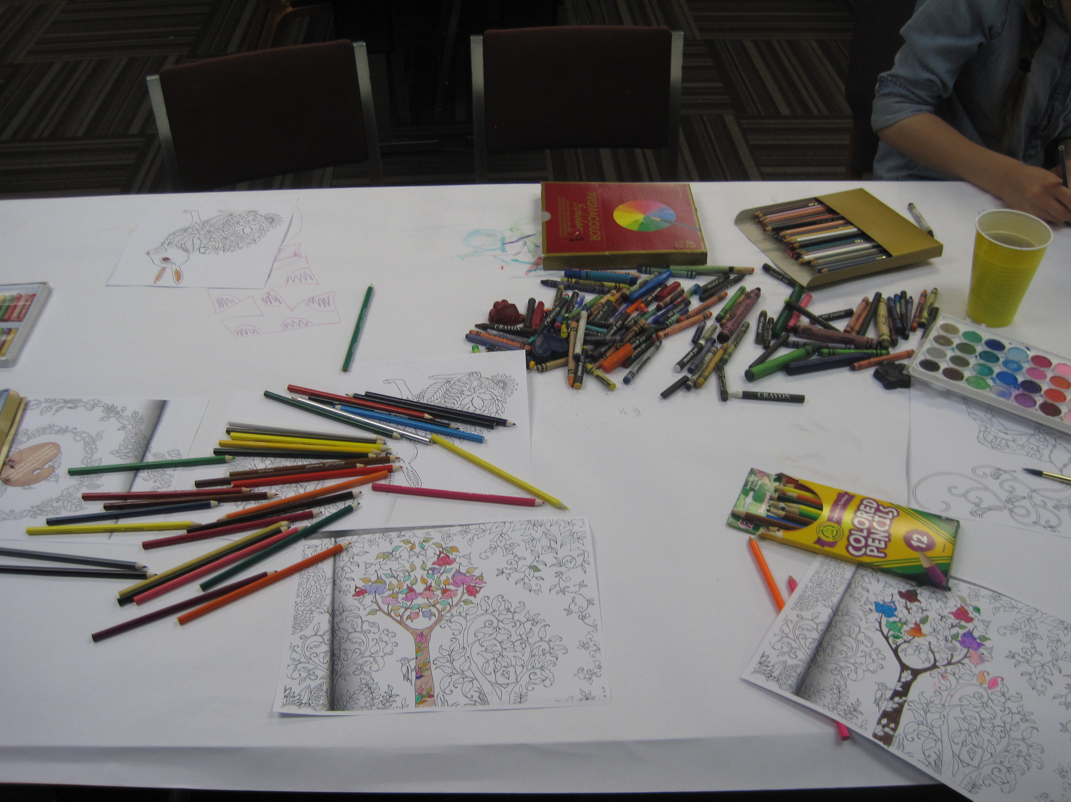
Programs

Slide 10
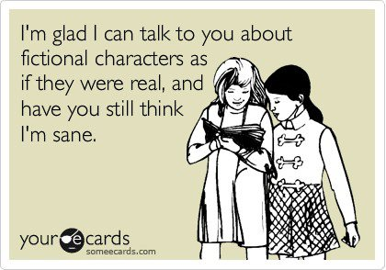
“Your reading brain senses a cadence that accompanies more complex writing, which your brain then seeks to emulate when writing” (Reynolds 2016)

Slide 11
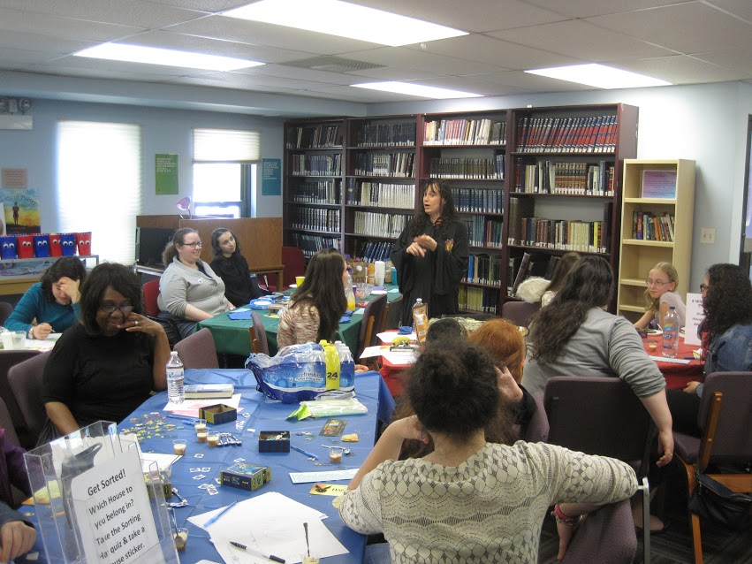
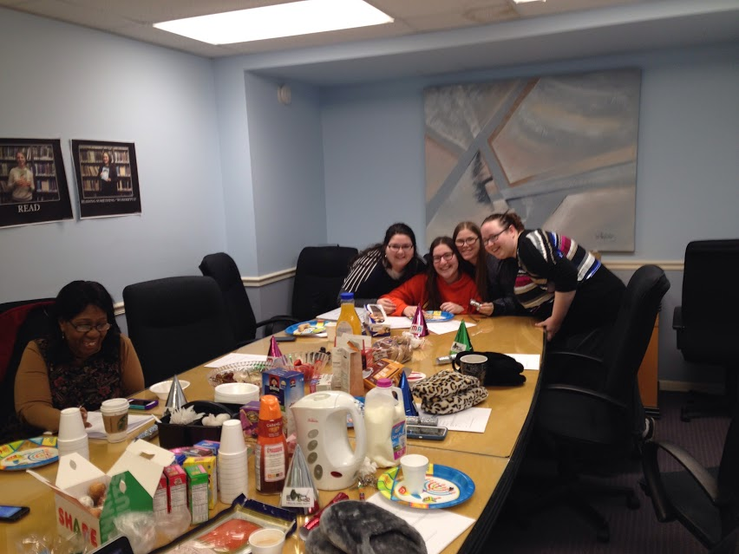
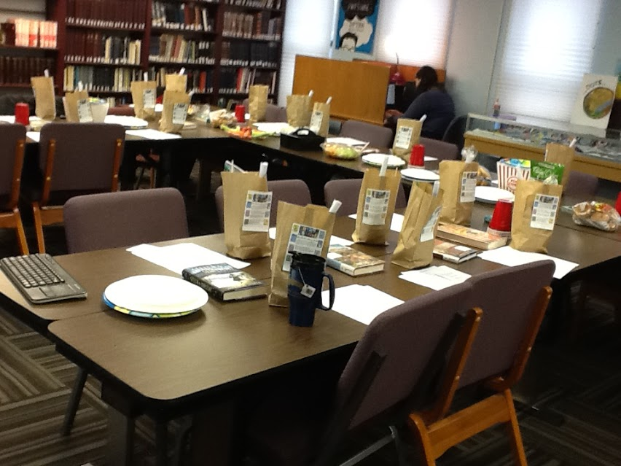
Book Club

Slide 14
It’s Your Library.
How will you
Own It?

