Slide 2
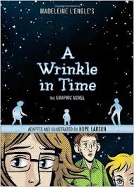

Slide 4
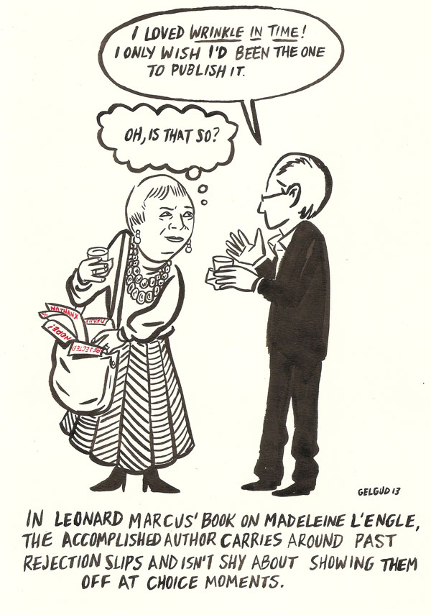
Rejection!
At least 26 rejections
Defies genre
"Was it for adults, was it for children? What is this, science fiction? Oh, I know what science fiction is, but there aren't female protagonists in science fiction. Are you sure you want to talk about good and evil — isn't that a little bit philosophical? Can't you just cut that part out?” - Charlotte Jones Voiklis (CJV)
Farrar, Straus, 1963

Slide 5
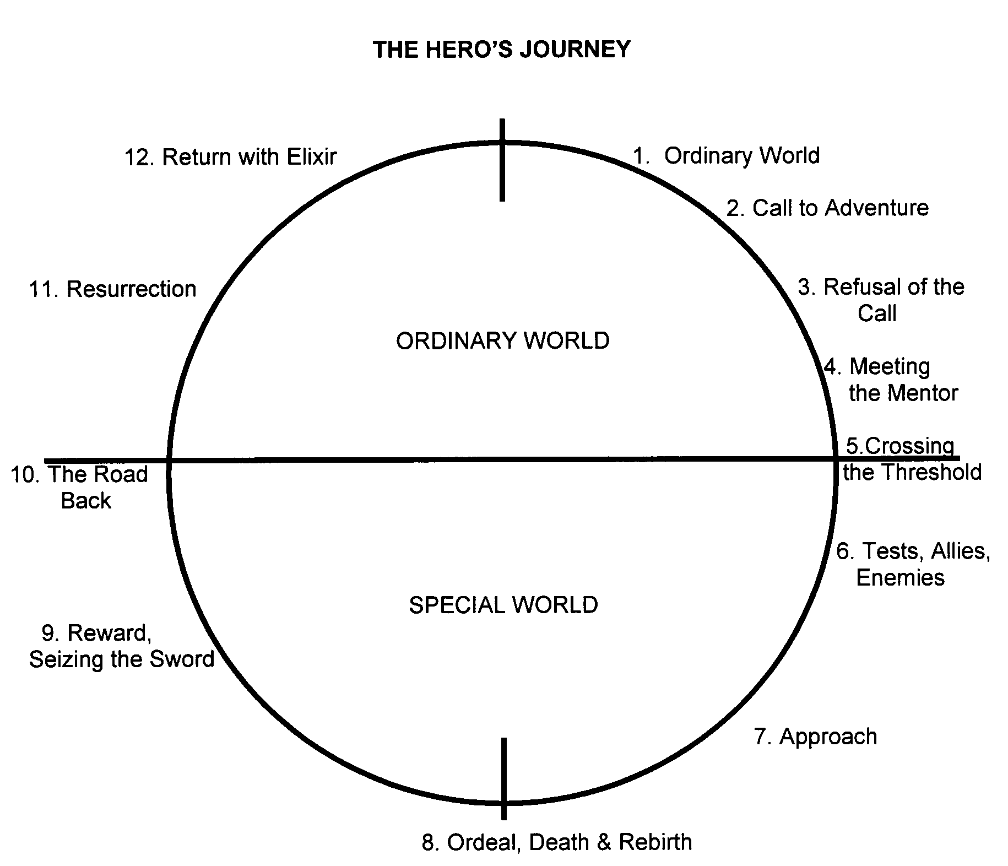
Source: http://www.thewritersjourney.com/hero's_journey.htm#Hero

Slide 6
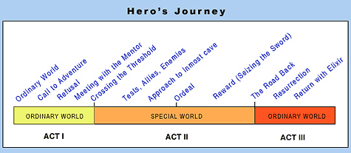
Source: http://www.movieoutline.com/articles/the-hero-journey-mythic-structure-of-joseph-campbell-monomyth.html

Slide 7
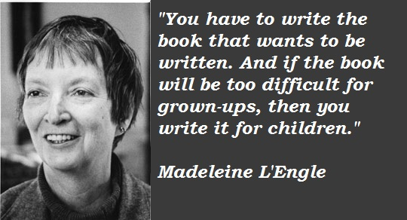

Slide 8
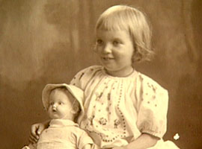
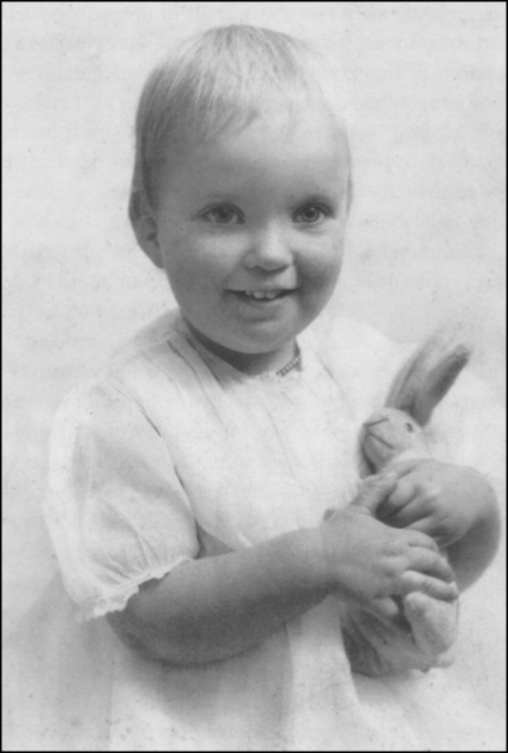
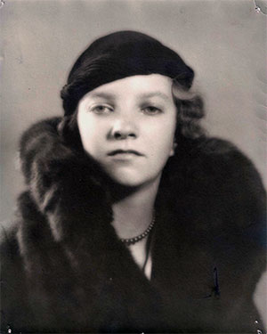
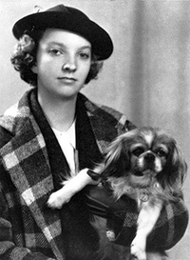
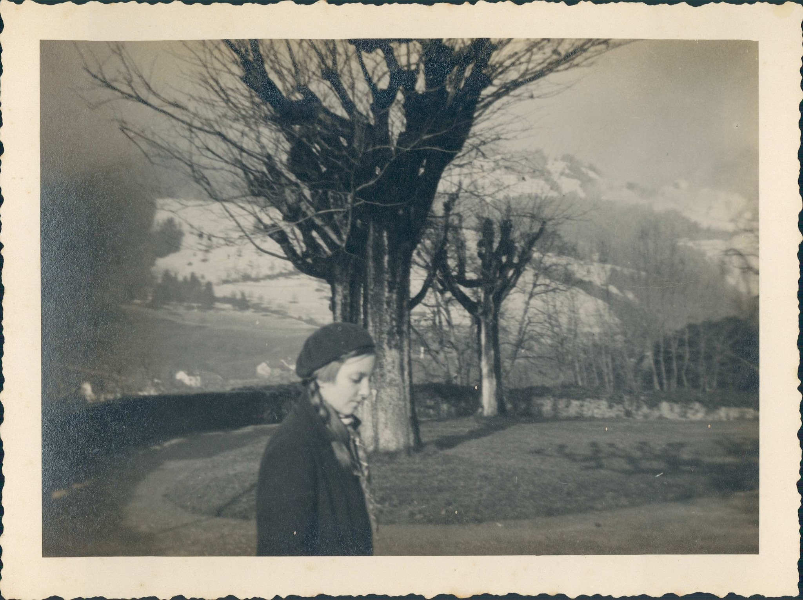

Slide 9
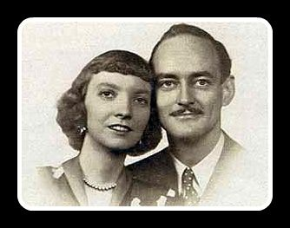
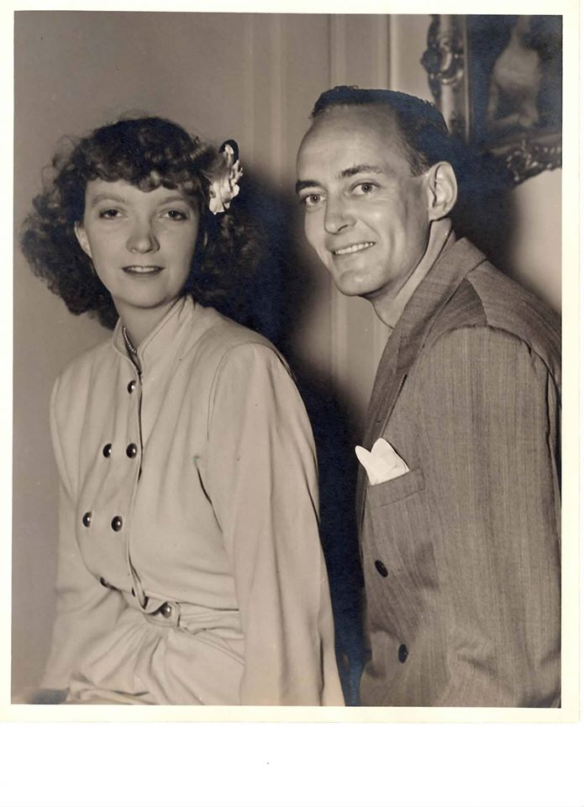

Slide 10
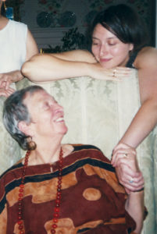
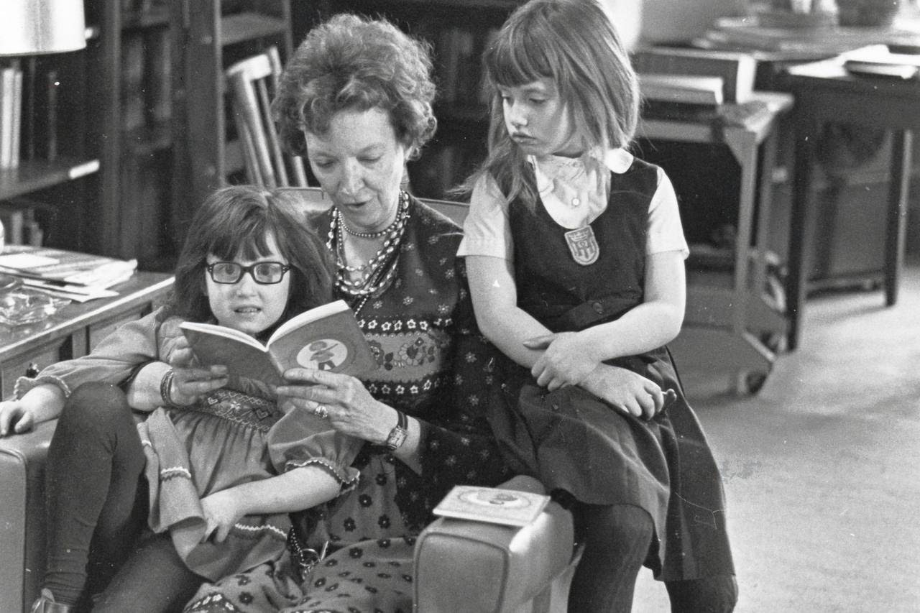

Slide 11
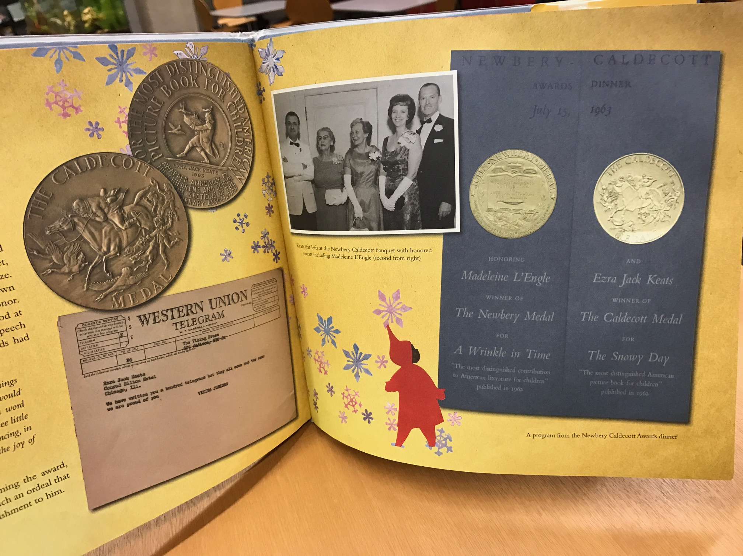

Slide 12
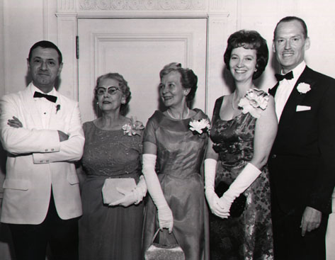

Slide 13
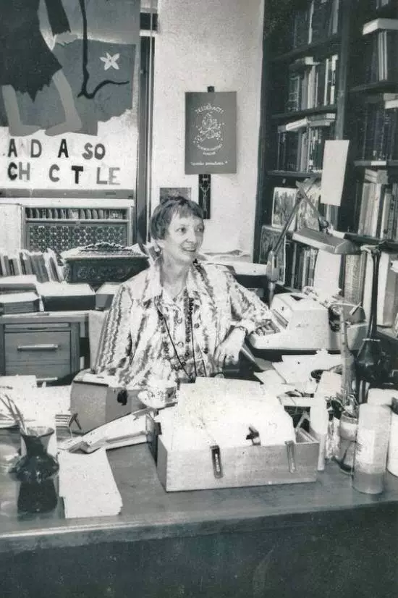

Slide 14
http://www.lifelinetheatre.com/performances/16-17/wrinkle/index.shtml

Slide 18
Love
“We can surely no longer pretend that our children are growing up into a peaceful, secure, and civilized world. We’ve come to the point where it’s irresponsible to try to protect them from the irrational world they will have to live in when they grow up. The children themselves haven’t yet isolated themselves by selfishness and indifference; they do not fall easily into the error of despair; they are considerably braver than most grownups. Our responsibility to them is not to pretend that if we don’t look, evil will go away, but to give them weapons against it.” – Madeleine L’Engle in A Circle of Quiet
The “weapon” that A Wrinkle in Time gives children is hope: hope that love can overcome hate, and that, even though evil may not ever be fully extinguished, our acts of love matter. It’s a lesson that is empowering and energizing, and one that we need reminding of when our courage fails. For it will fail. Sometimes the world looks very dark indeed.
“Love, Gran insisted, is not a power, which she always considered coercive. To love is to be vulnerable; and it is only in vulnerability and risk – not safety and security – that we overcome darkness” – Charlotte Jones Voiklis

